Slide 1
SALES MANAGEMENT SYSTEM
GROUP-8 :
NAKRANI DEEP DINESHCHANDRA CS-19162171022
PANCHOLI VIDHAN RAJUL CS-19162171024
PANCHAL HARSH CS-19162171023

Slide 2

INTRODUCTION
WHAT IS SALES MANAGEMENT
The process of planning, directing, and controlling of personal selling, including recruiting, selecting, equipping, assigning, supervising, paying, and motivating the personal sales force.
This Photo by Unknown Author is licensed under CC BY-NC-ND

Slide 3
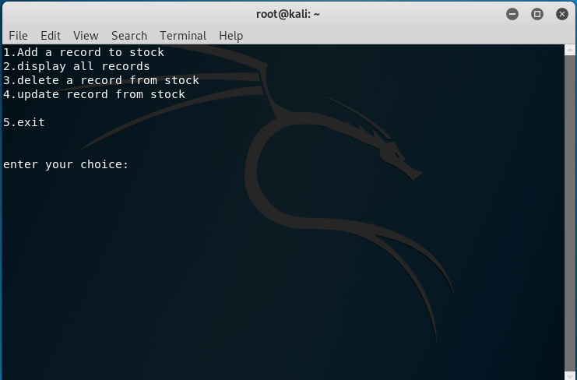
IMPLEMENTATION OF CODE
When you run the code you will see the following output

Slide 4
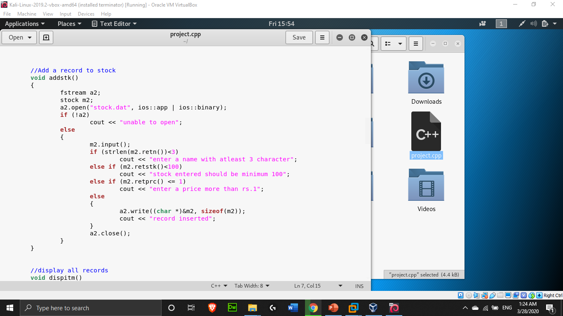
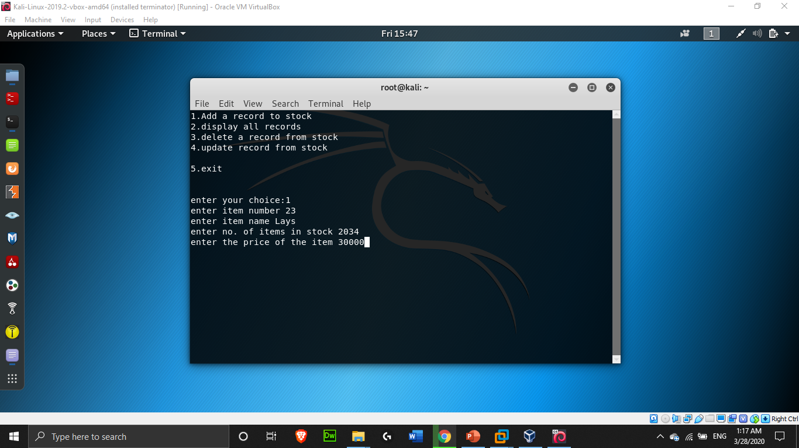
When you press number 1, it will open record function and will add a record of stock.
Item number
Item name
Stock
Item Price

Slide 5
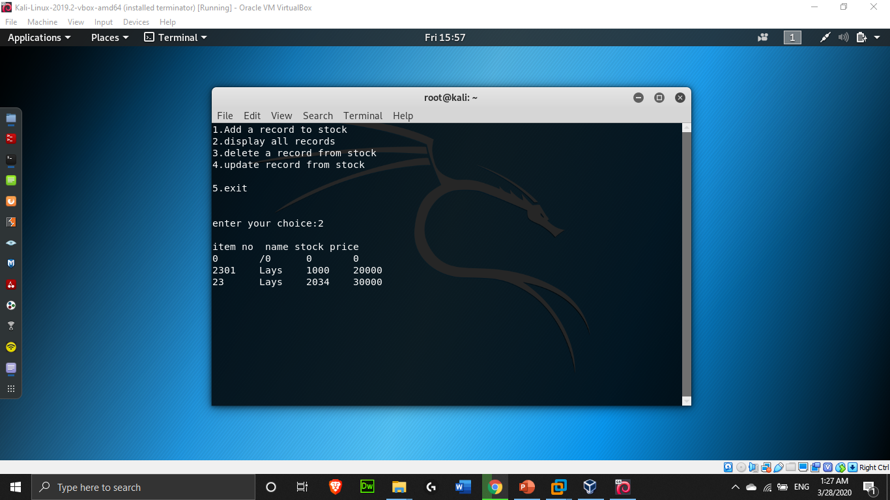
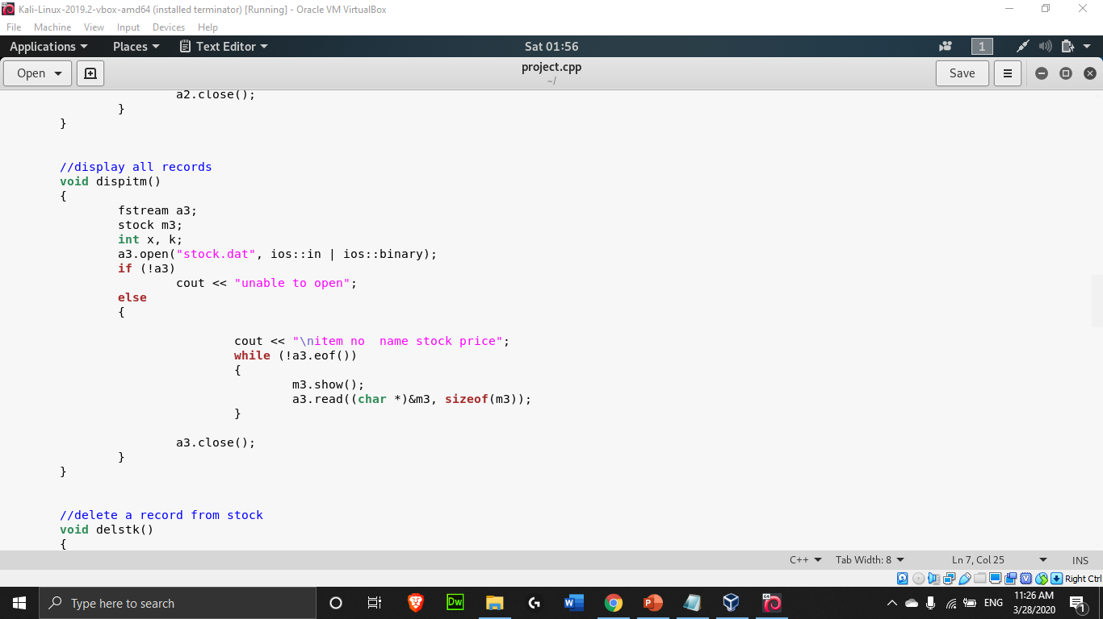
When you press 2 it will display all the record you have entered till now and the code with output is shown below.

Slide 6
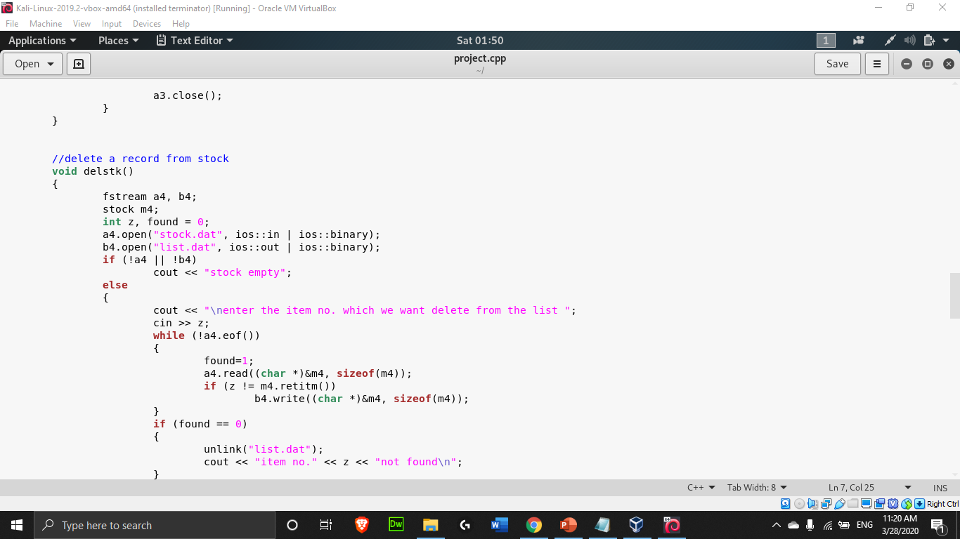
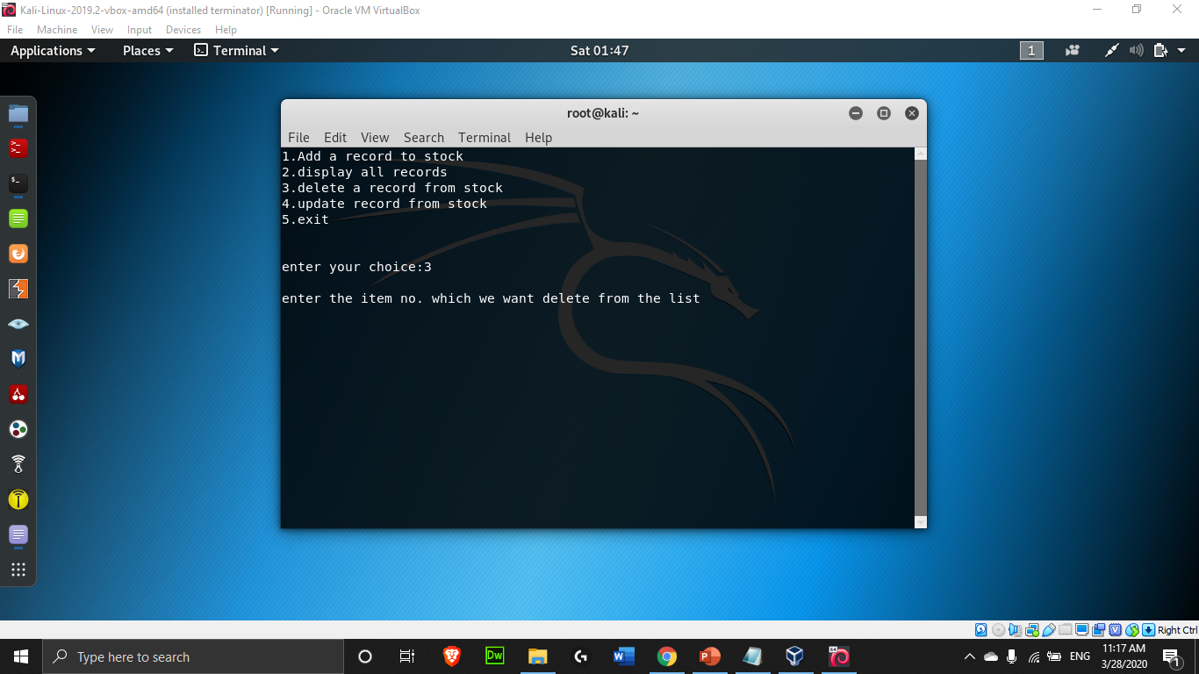
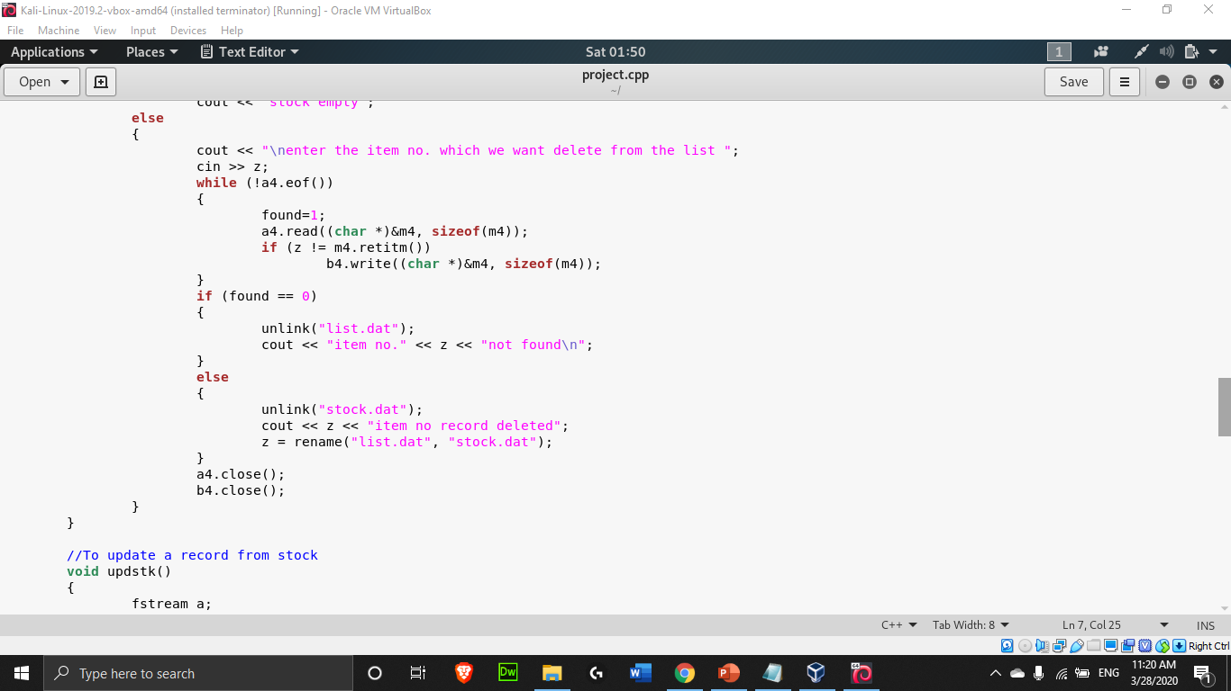
When you press 3 it will ask you for the item number an if number matches to the enterd item it will delete its record.
Here a temporary file is used to delete a record.

Slide 7
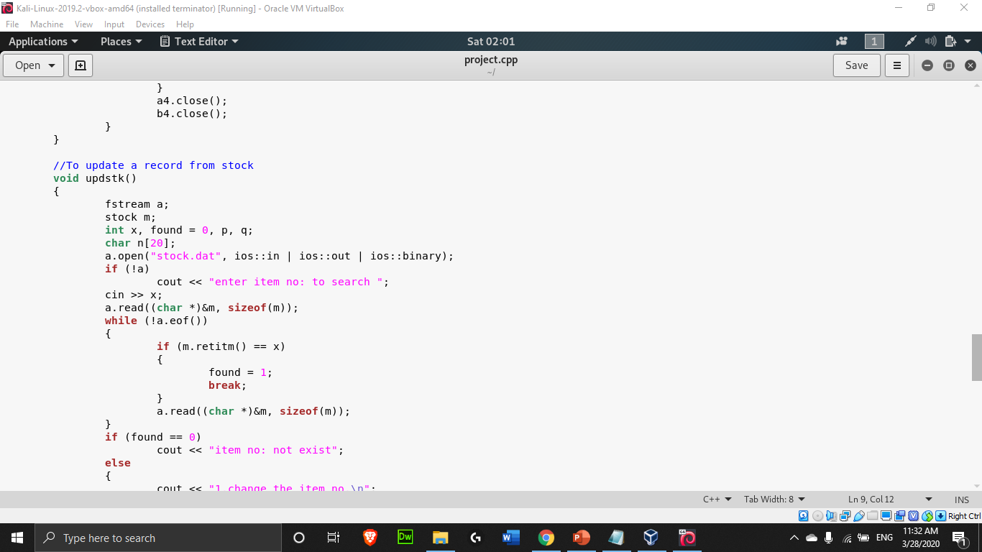
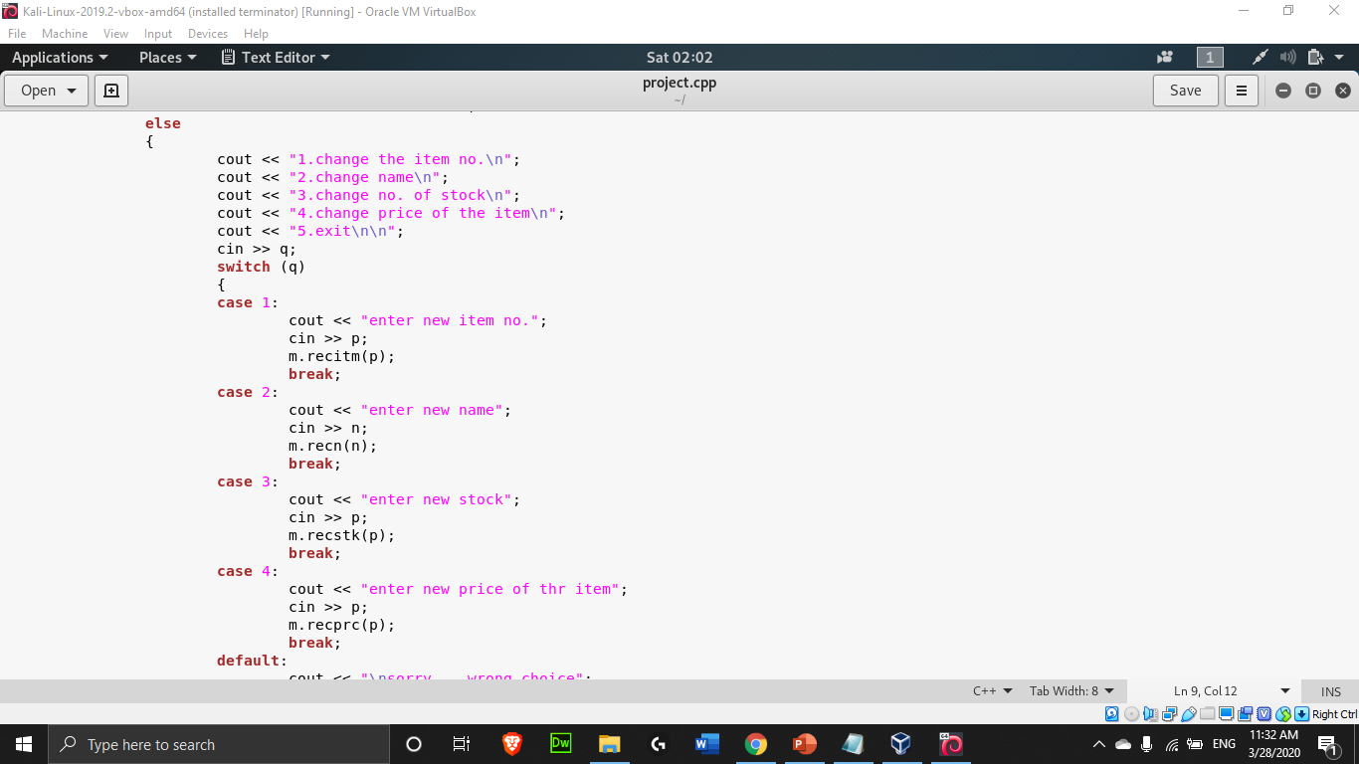
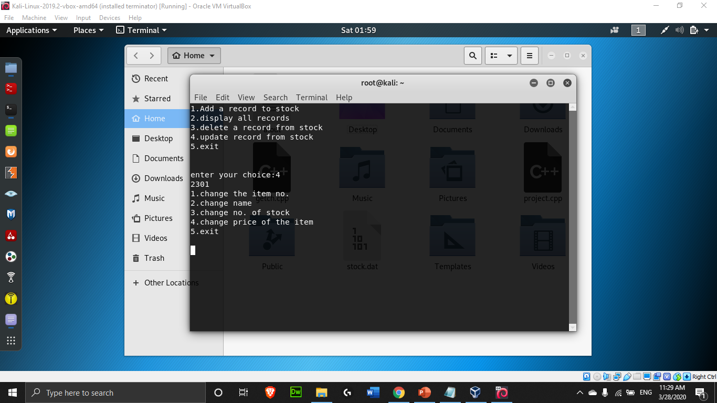
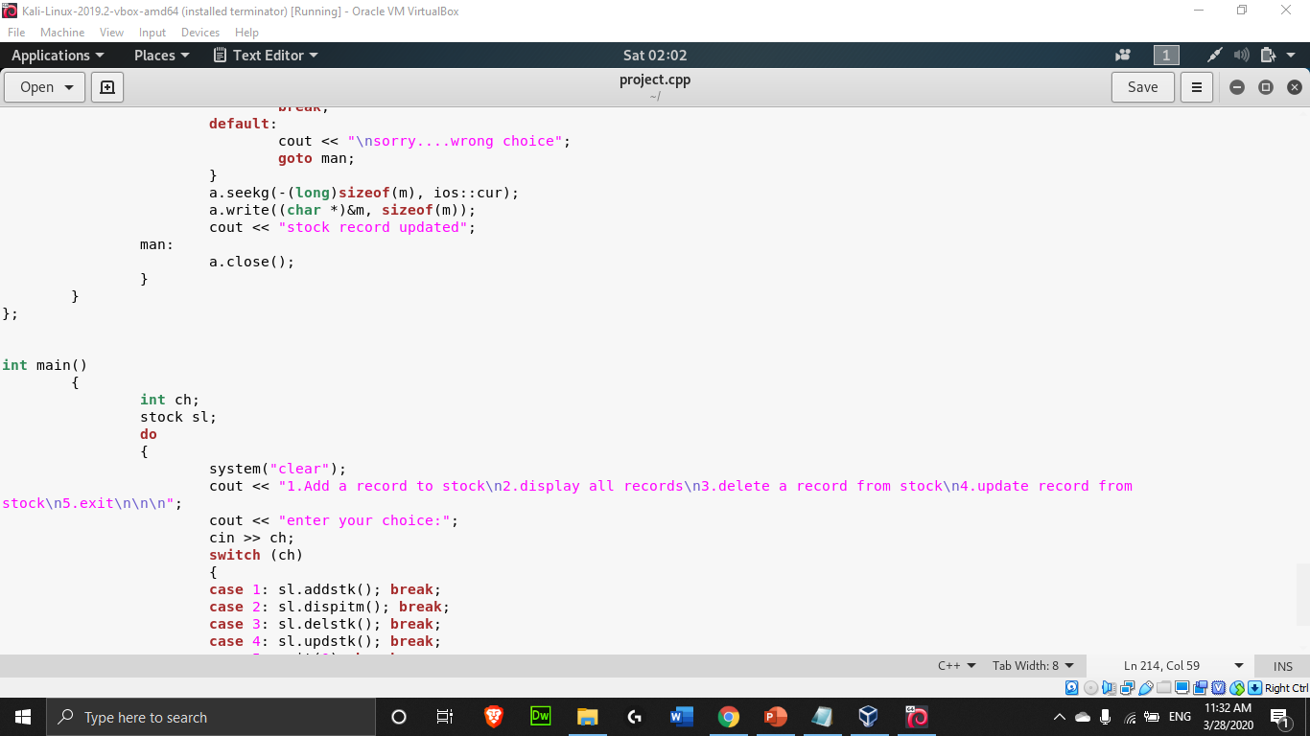
When you press 4, you have to enter the item number and it will show the following options
Change the item no.
Change name
Change no. of stock
Change price of the item

Slide 8
THANK YOU

